Slide 1
Progress Report
Lily Chang

Slide 2
Data
Noise Complaints - noise complaints in MoCo from 1989-2026
Used mutate to create a month variable
Used mutate and case_when to clean a variable with typos/repeated entries
New Home Builders - Licenses given to build residential homes in MoCo
Removed some columns
Department of Alcohol Beverage Services (ABS) Licensee Data - List of establishments licensed to sell alcohol in MoCo
Used mutate and case_when to clean a city variable due to several different typos

Slide 3
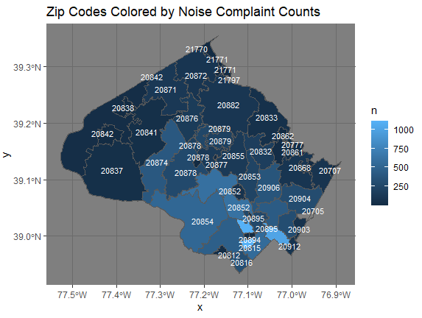
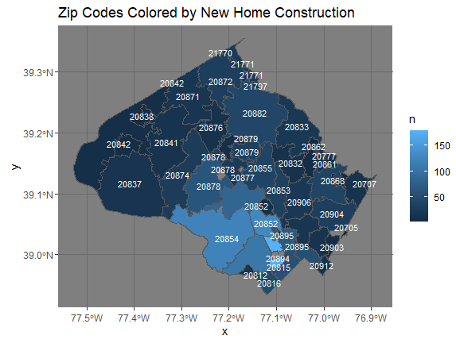
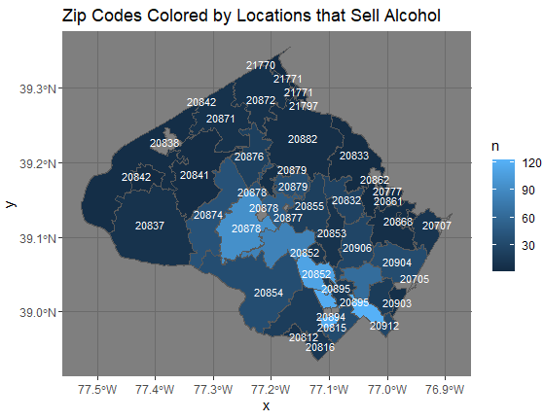
Exploratory Data Analysis
Choropleths
Which areas are hot-spots
Areas with more construction complaints and establishments that sell alcohol tend to have higher noise complaint counts, suggesting a relationship
My main takeaway
As seen in the choropleths, Bethesda and Silver Spring are consistently within the top zip codes with the highest counts across all of the datasets

Slide 4
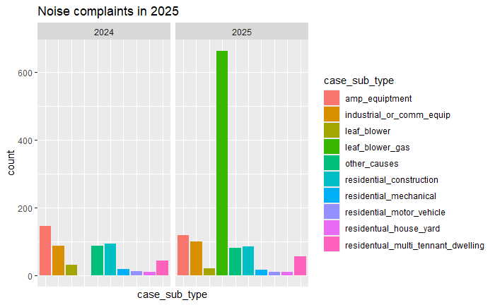
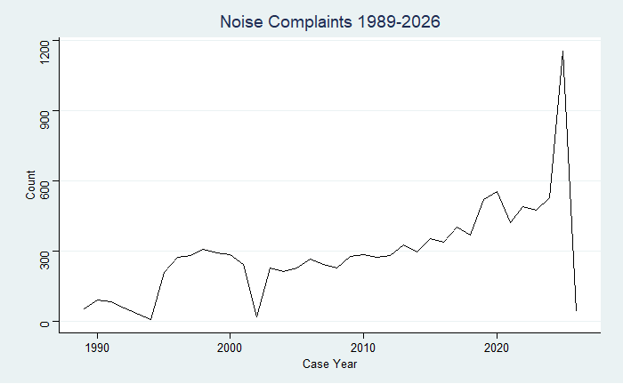
Exploratory Data Analysis 2
There were fewer complaints in 2024 due to leaf blowers, a possible explanation is that the spike could stem from conflict within the community and not an overall increase in noise
While noise complaints are increasing over
time, it’s unlikely that Montgomery County actually
got significantly louder in 2025.

Slide 5
How does my EDA support my planned analyses and research goals.
My target audience is people who are noise sensitive and might want advice on where they should live.
Silver Spring and Bethesda get more complaints, may want to avoid those areas
They likely have higher complaint counts due to their proximity to D.C., population concentration, higher amounts of construction, and potentially nightlife.

Slide 6
Next steps
Start aligning my data with my research to make a cohesive narrative
Collect the pieces of my narrative and ensure it can be delivered within the time limit
Look into mapping forecasted data to compare to current maps
I have already used ARIMA to forecast my data
When ran on all of my data I get random walk
When ran on the stable parts of my data, I get a model that indicates a steady increase.
Negative Binomial regression

Slide 7
Thank you!

